Slide 1
TROPICAL CYCLONE INTENSITY ESTIMATION USING DEEP LEARNING
PROJECT GUIDE:
Dr.K.KUMAR
AP-CSE
BY:
ARTHI V
MIRNALINI S
MONISHA K
NISHANTHINI B
RANI PANDEY

Slide 2
INTRODUCTION
Tropical cyclones (TCs) are one of the most destructive natural disasters, threatening both lives and property. The effect of TCs include strong wind, heavy rain, tornadoes and large storm surges near landfall.
The destruction of a TC mainly depends on its intensity, size, and location.
Therefore, accurate estimation of TC intensity plays an important role in operational TC forecasts as well as for disaster prevention and mitigation
Since most TCs develop over the ocean, it is extremely difficult to estimate TC intensity using ground-based observations alone.

Slide 3
LITERATURE SURVEY:
S.NO | TECHNIQUES USED | DATASET | ADVANTAGE | DISADVANTAGE
[1] | DT,RF,XGBoost,Gradient boosting machine,SVM | Textual data contain Origin,Latitude,Longitude,Pressure drop | Inferenced that higher accuracy in XGBoost | Not based on satellite imagery
[2] | LeNet,Alexnet | Images of classified cyclones | Best classifier | Intensity estimation accuracy is moderate
[3] | CNN architecture | Cyclone-cloud Satellite images | Achieved higher accuracy | Higher accuracy than only DT
[4] | CNN with attention layer | Cyclone-cloud Satellite images | Achieved higher accuracy than CNN | several factors affects its intensity calculation

Slide 4
S.NO | TECHNIQUES USED | DATASET | ADVANTAGE | DISADVANTAGE
[5] | 2D-CNN,3D-CNN | COMS Satellite data(IR images) | Found that pattern of inner core part of TC was closely related to TC intensity. | Error value was found as 11.31kts which is little higher.
[6] | Multi-layer Perceptron | Images of Indian Satellite data | This model works better than Dvorak technique . It works well with geometric property. | The first and more obvious limitation of the multilayer perceptron is training time. It takes an awful lot of iterations for the algorithm to learn to solve a very simple logic problem.

Slide 5
PROPOSED SOLUTION
Satellite-based observations, such as microwave data from polar-orbiting or geostationary satellites, have been considered as the primary data source to estimate TC intensity.
In our experiment, a set of deep convolutional networks was designed for estimating the intensity of tropical cyclone.
We planned to use CNN that is Resnet architecture, vgg19 model and inception resnet-v2 architecture.

Slide 6
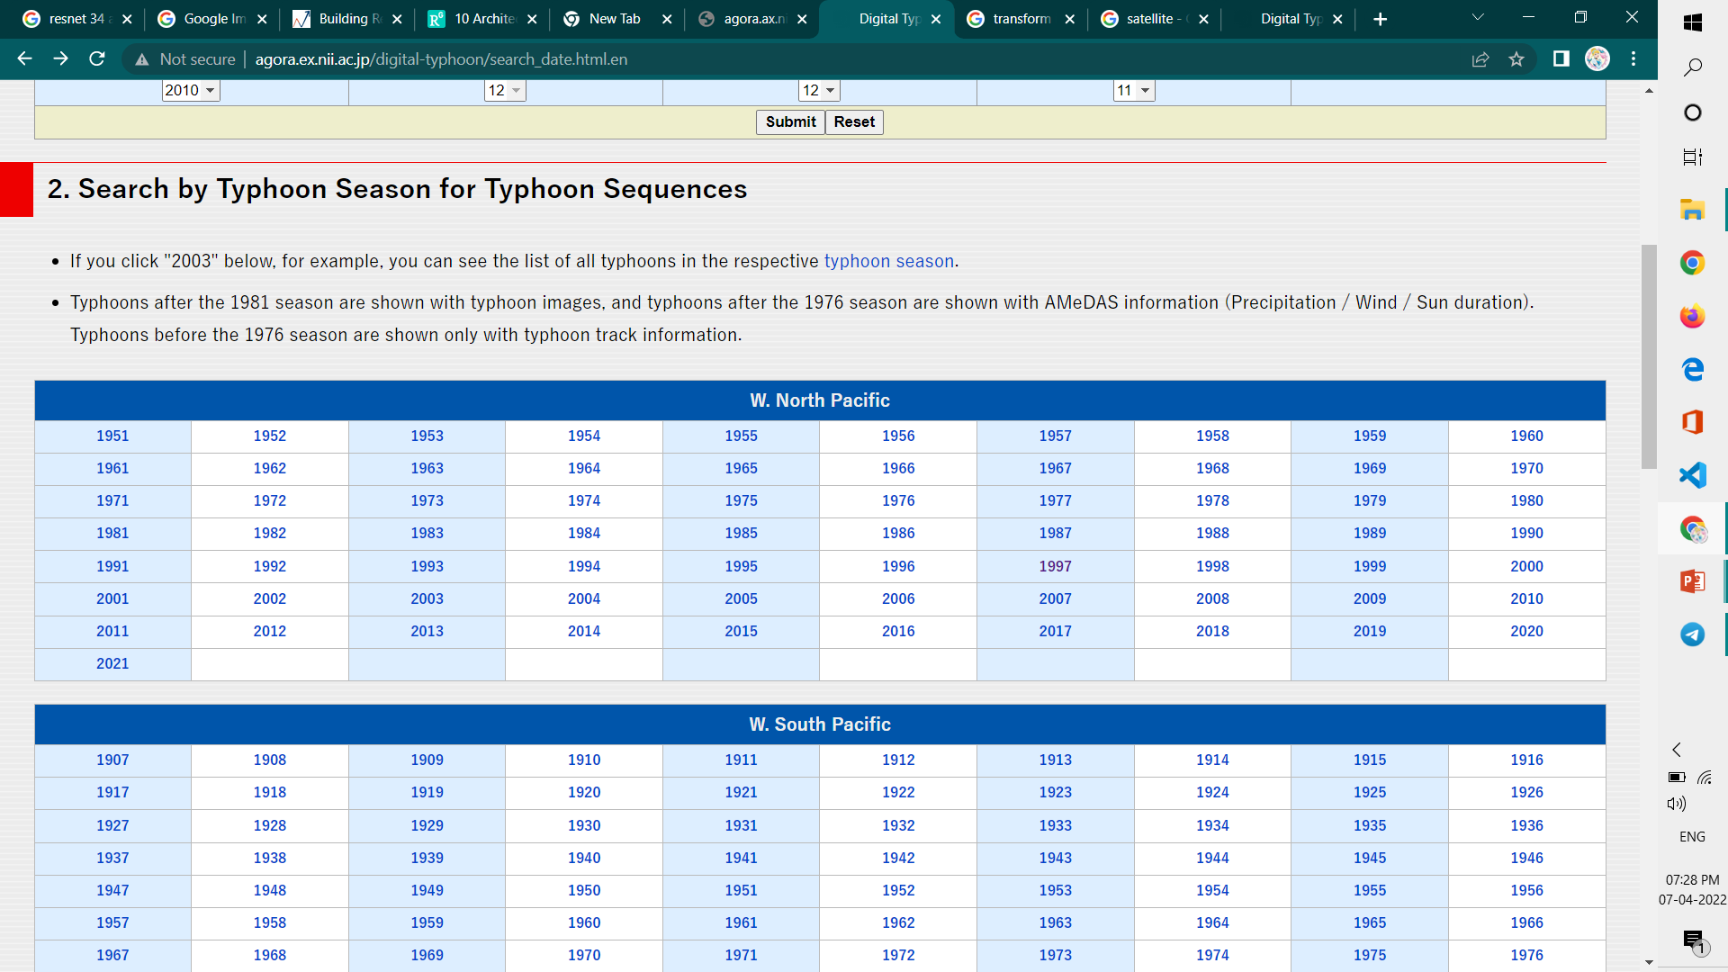
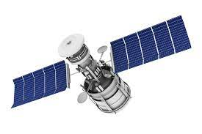
FLOW CHART
IR images
Image Processing
6 Hourly updated images
agora.ax.nii.ac.jp/digital-typhoon
Train Dataset
Test Dataset
Annotation
Himawari-8 Satellite
Prediction
RMSE ,MAE
Deep Models

Slide 7
DATASET COLLECTION
The Satellite Images of Tropical Cyclone are integrated in digital typhoon website of Japan provided by Japan Meteorological Agent. Hence dataset was fetched from that website.
It has all the Satellite Images of Tropical Cyclone from 1951 to 2021 but we fetched the data of West-North of Pacific Ocean from 1977 to 2021.
The Website also have the additional information such as Timestamp, Wind, Central Pressure , birth, death, name of the cyclone etc...
For our dataset we fetched Timestamp, Wind , Central Pressure and also kept that as our file name.

Slide 8
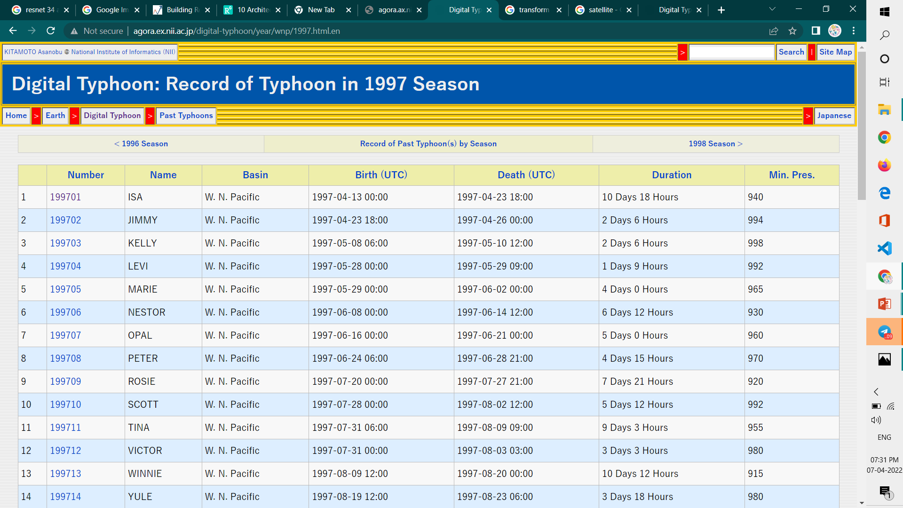
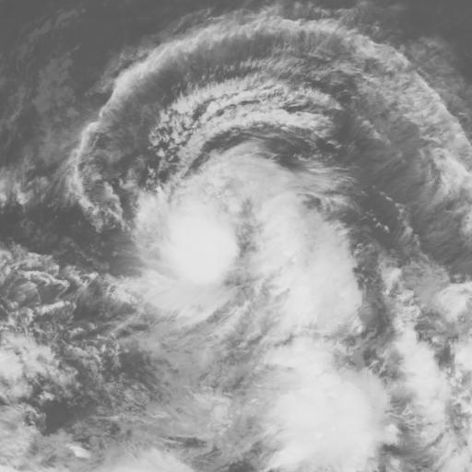
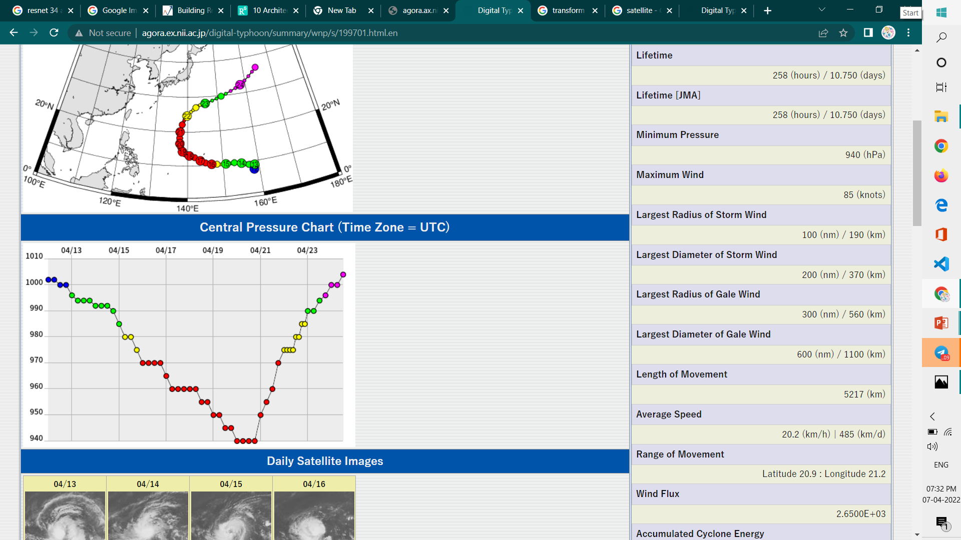
199701_16072718_55_980
Year
Month
Timestamp
Wind
Central Pressure
199701_16072718_55_980.jpg

Slide 9
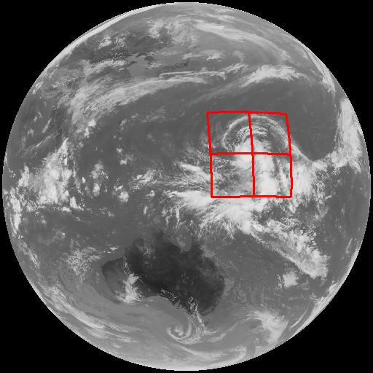
IMAGE PREPROCESSING
After the dataset collection ,the image preprocessing includes few steps such as crop, resize and transform.
CROP – the collected images are cropped by calling “crop function” in create
sample.
RESIZE – after cropping ,the images are resized into the resolution of
128x 128 x 384 x384.
TRANSFORM - Randomly selects a rectangle region in an torch Tensor image
and erases its pixels. Convert a tensor image to the given dtype and scale the
values accordingly This function does not support PIL Image.

Slide 10
SPLITTING THE DATASET
After the image preprocessing, the train set fetch the processed image
Then the dataset is splitted into training(80%) and testing (20%) dataset.
The total count of training images=10652
The total count of testing images =4200

Slide 11
PROPOSED MODEL:
The architecture model that we proposed are,
ResNet-34
VGG-19
Inception ResNet v2

Slide 12
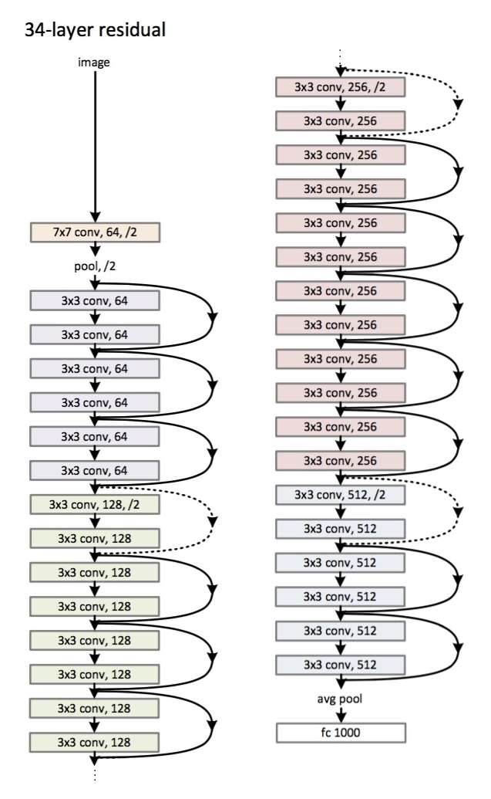
ResNet-34 ARCHITECTURE:

Slide 13
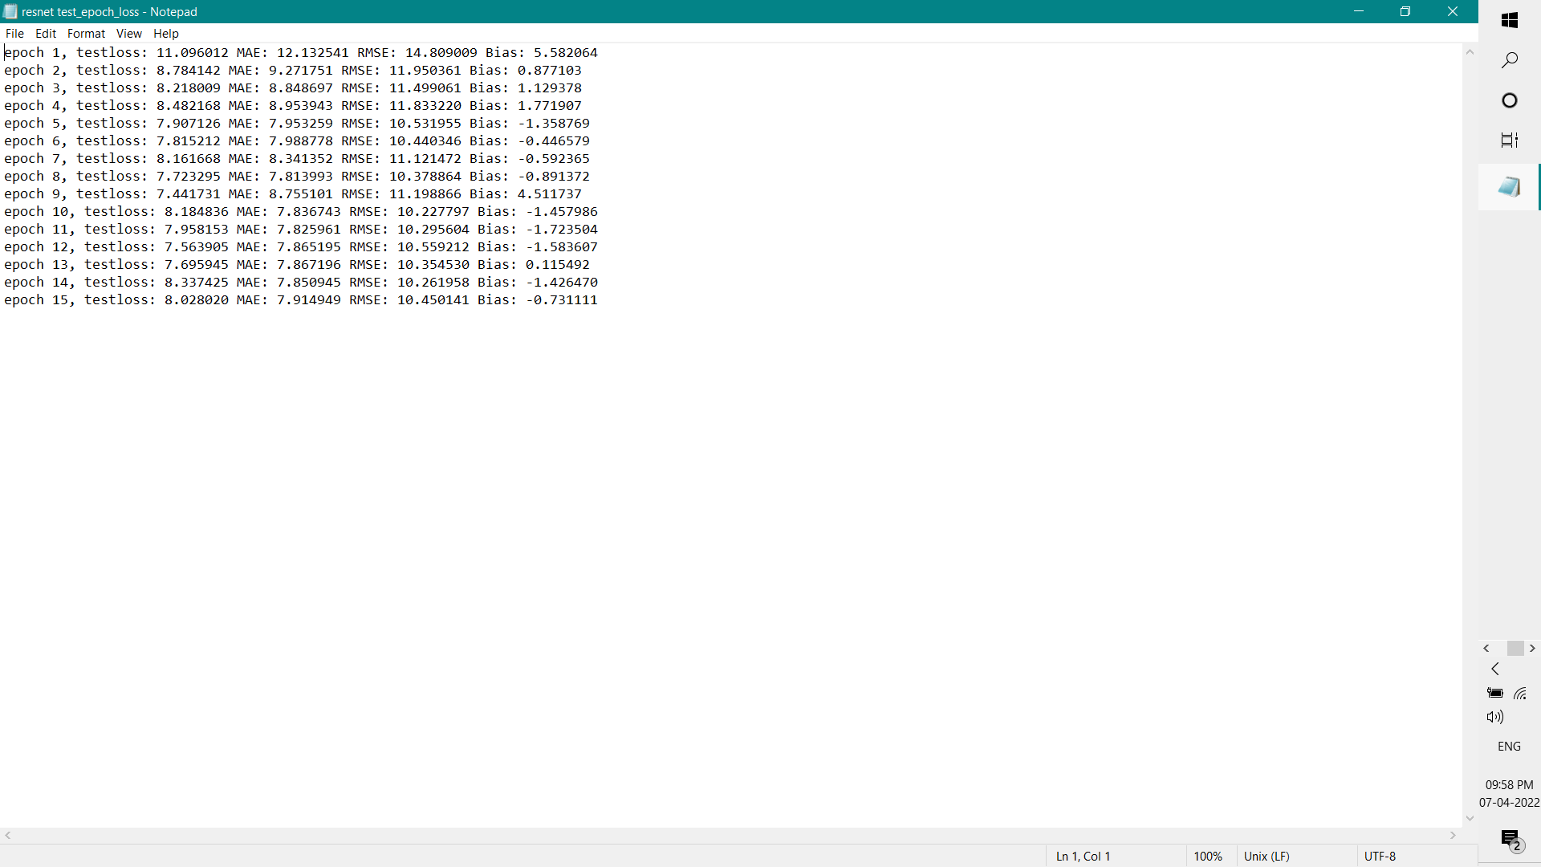
TRAINING:

Slide 14
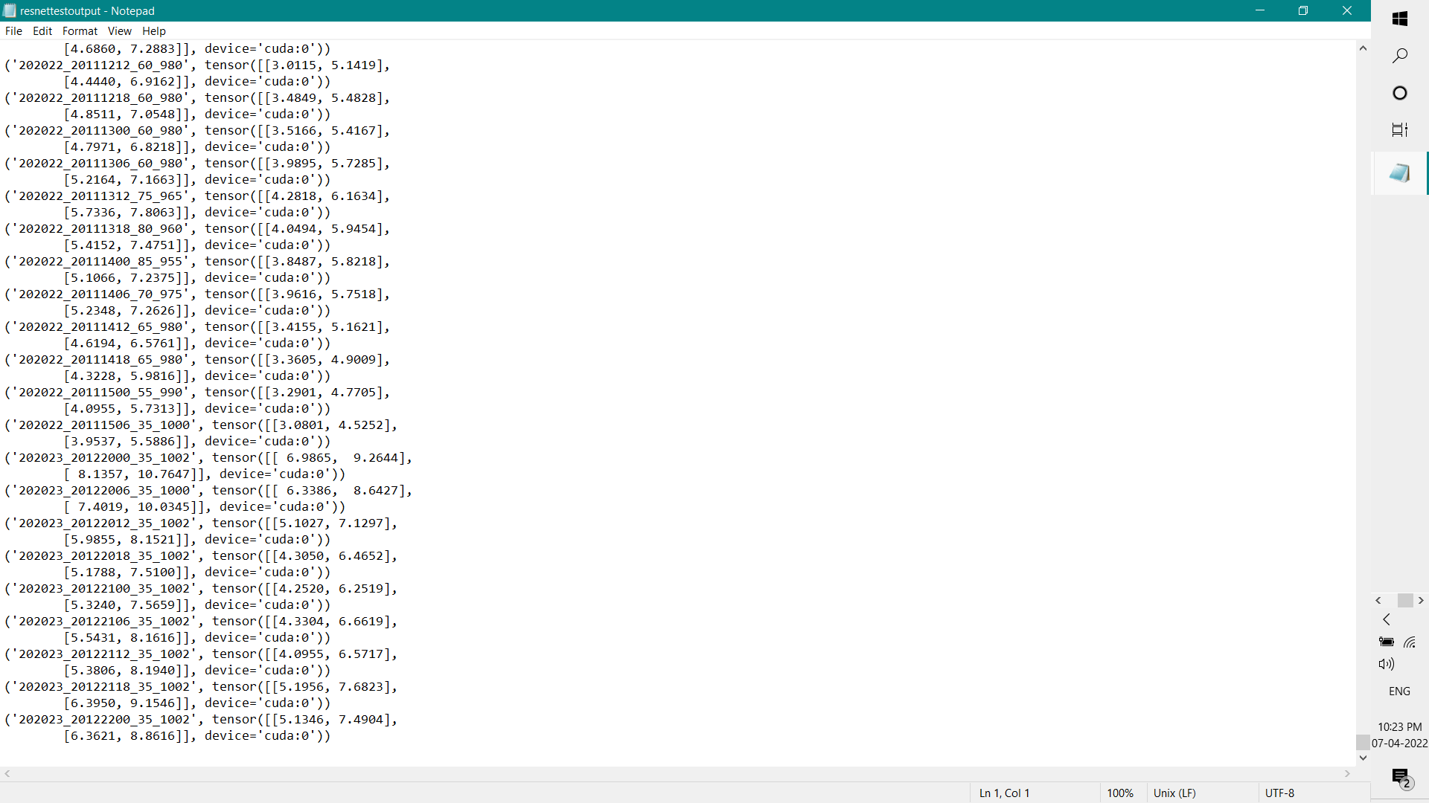
TESTING:

Slide 15
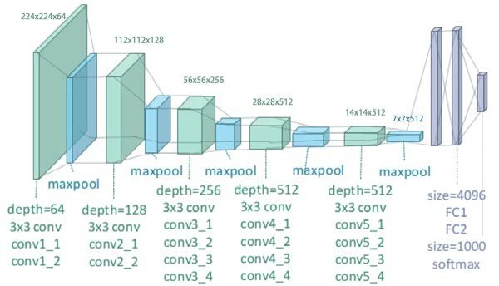
VGG-19 ARCHITECTURE:

Slide 16
FUTURE WORKS:
Implementation of Inception resnet-v2 and VGG-19 architecture.
Classification of Cyclone based on Intensity
Usage of Indian dataset for training and testing the implemented model

Slide 17
REFERENCE:
Leroux, M.D.; Wood, K.; Elsberry, R.L.; Cayanan, E.O.; Hendricks, E.; Kucas, M.; Otto, P.; Rogers,R.; Sampson, B.; Yu, Z. Recent advances in research and forecasting of tropical cyclone track, intensity, and structure at landfall. Trop. Cyclone Res. Rev. 2018,7,85–105.
Courtney, J.B.; Langlade, S.; Sampson, C.R.; Knaff, J.A.; Birchard, T.; Barlow, S.; Kotalg, S.D.; Kriat, T.; Lee, W.; Pasch, R.; et al.Operational perspectives on tropical cyclone intensity change part 1: Recent advances in intensity guidance. Trop. Cyclone Res. Rev. 2019,8, 123–133.
Zhang, C.J.; Wang, X.J.; Ma, L.M.; Lu, X.Q. Tropical cyclone intensity classiﬁcation and estimation using infrared satellite images with deep learning. IEEE J. Sel. Top. Appl. Earth Obs. Remote Sens. 2021,14, 2070–2086
Regional Specialized Meteorological Centre for Tropical Cyclones over North Indian Ocean,IMD Frequently asked Question. http://www.rsmcnewdelhi.imd.gov.in/images-/pdf/cyclone awareness/terminology/faq.pdf. Accessed 1 Aug 2019
https://doi.org/10.3390/rs12010108

Slide 18
THANK YOU

